Slide 1
Cohort Studies
This is the development version of the lab warm-up. Erase this text box, erase all comments, and “save as” to create the version shared with students.
Or, just move slides over to the production version one at a time as you complete changes to them.
Analysis
Notes:
Last week we discussed the design and conduct of cohort studies. This week, we will learn more about analyzing and interpreting data collected from cohort studies.

Slide 2
Exposure Occurrence
Time
Notes:
As a reminder, in the basic prospective cohort study design, there is some source population out in the world. In that source population, some person or force other than us is choosing whether people are exposed to something we are interested in or not.

Slide 3
Where:
Orange = Exposed
Blue = Unexposed
👩🏽‍⚕️👨‍🔬
Cohort Identified
Exposure Measured
Exposure Occurrence
Time
Notes:
Then, we – the epidemiologists – come along and measure how much exposure each person in the cohort had. For this example, there are only two possible levels of exposure: Exposed and unexposed. The orange dots are exposed people and the blue dots are unexposed people.
Now, our goal is to follow these people over some period of time and figure out if exposed people are more likely to get the outcome or if unexposed people are more likely to get the outcome. That being the case, it wouldn’t make much sense to include people in our cohort who already have the outcome, right? Therefore, each member of our cohort should be free of the outcome of interest at the beginning of follow-up.

Slide 4
Where:
Orange = Exposed
Blue = Unexposed
Circle = No Outcome
Triangle = Outcome
Outcome Measured
in Exposed
An incident of the outcome
👩🏽‍⚕️👨‍🔬
Cohort Identified
Exposure Measured
Exposure Occurrence
Collectively, there are 6 incidents
Outcome Measured
in Unexposed
Time
Notes:
Next, we just let some time pass and see who develops the outcome and who doesn’t.
We might also say that each time a person gets the outcome, it is an incident occurrence. In this case, each triangle represents an incident.
Further, we can count the number of incidents – pay attention to the spelling here. For example, there are 6 incident outcomes in the exposed group here.

Slide 5
Where:
Orange = Exposed
Blue = Unexposed
Circle = No Outcome
Triangle = Outcome
Outcome Measured
in Exposed
👩🏽‍⚕️👨‍🔬
Cohort Identified
Exposure Measured
Incidence Proportion
Exposure Occurrence
Compare Incidence Proportion
Outcome Measured
in Unexposed
Incidence Proportion
Time
Notes:
Finally, after enough time has passed, we will calculate the risk of the outcome in the exposed group, the risk of the outcome in the unexposed group, and compare the two.
As a side note, we are using the word “risk” here colloquially. More specifically, we will typically calculate the incidence proportion in both groups and then compare them as either a ratio of one another or the difference between one another. We will see examples of both soon.

Slide 6
Description
Causation
Prediction
Notes:
Ultimately, we will want to use these calculations to make some descriptive observations about the exposure and/or outcome, make some predictions about the exposure and/or outcome, provide some explanations for why the outcome occurs, or do something to intervene on outcome occurrence. For the rest of this module, we will practice doing some of these calculations.

Slide 7
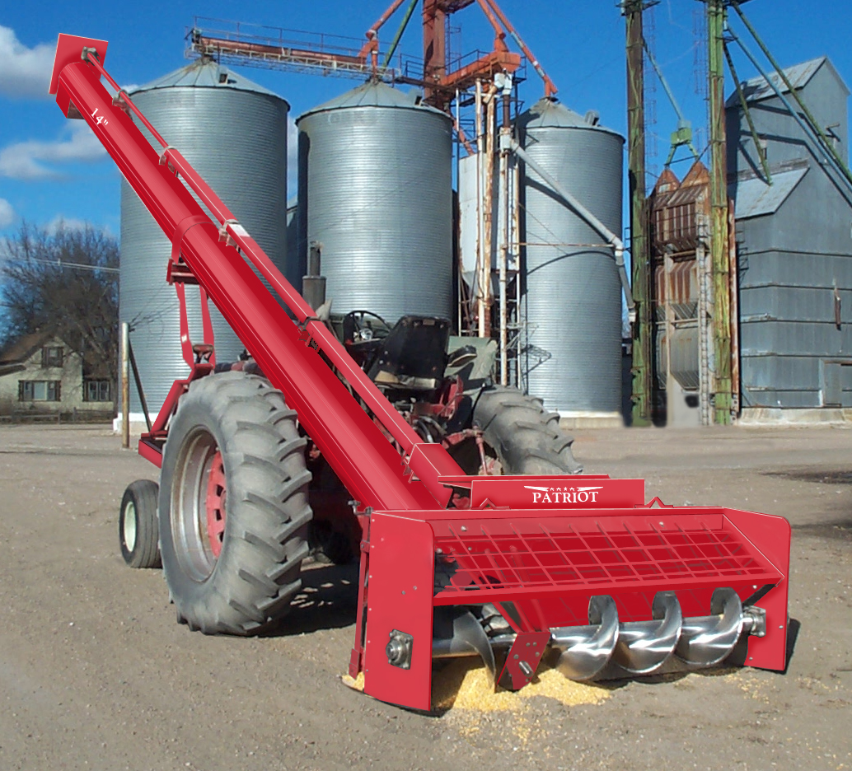
Notes:
Unintentional injuries are the leading cause of death among Americans between the ages of 1 and 44 years, and the use of grain augers is believed to be the leading cause of unintentional injuries among agricultural workers in the United States. To make our upcoming examples more concrete, let’s assume we are interested in investigating the relationship between grain auger use and unintentional injurings among agricultural workers in the United States.

Slide 8
👩🏽‍⚕️👨‍🔬
Cohort Identified
Exposure Measured
Where:
Orange = Auger
Blue = No Auger
Circle = No UI
Triangle = UI
Time
Notes:
To keep things relatively simple, let’s say that we only enrolled 12 workers in our cohort and we accurately measured whether they use a grain auger at work or not. In a more rigorous study, we may also want to collect detailed information about the frequency and duration of grain auger use. That is, how often they use a grain augur and how long each use lasts. But, we will just collect a simple yes/no measure of grain auger use for this example.
In our figure, the orange color represents agricultural workers who use a grain auger at work and blue color represents agricultural workers who do NOT use a grain auger at work.
Further, circles represent agricultural workers who have not experienced the outcome of interest – unintentional injury – and triangles represent agricultural workers who have experienced unintentional injuries. Notice that at the beginning of our study there are only circles. This is because no member of our cohort has experienced the outcome of interest yet. Said another way, every member of our cohort is at risk of experiencing the outcome of interest.
In reality, it is obviously unlikely that any person who has lived long enough to begin working in the agricultural industry has never had an unintentional injury. Therefore, our case definition for this study would likely include something about experiencing the injury while working. Further, because a person can experience an injury more than one time, we will restrict our study to first-time workplace injuries only for this example.

Slide 9
Outcome Measured
in Exposed
👩🏽‍⚕️👨‍🔬
Cohort Identified
Exposure Measured
Outcome Measured
in Unexposed
Where:
Orange = Exposed
Blue = Unexposed
Circle = No Outcome
Triangle = Outcome
1 Year
Notes:
Now, let’s say that we collected data about unintentional injuries from our cohort members every month for one year. To further simplify things, let’s say that every person gives us complete and accurate information every month over the course of that year. Under those conditions, we could graphically depict our data like this.

Slide 10
Outcome Measured
in Exposed
👩🏽‍⚕️👨‍🔬
Cohort Identified
Exposure Measured
Over a one-year period, 4 members of the agricultural
Outcome Measured
in Unexposed
👩🏽‍⚕️👨‍🔬
Where:
Orange = Exposed
Blue = Unexposed
Circle = No Outcome
Triangle = Outcome
1 Year
Notes:
And from that information, we could begin to draw some conclusions from our study. For example, we could note that 4 out of the 12 agricultural workers in our study work with a grain auger. If we sampled our cohort in a way that we would expect to produce an unbiased sample with respect grain auger use in our target population, then we could reasonably estimate that approximately 4 out of 12, or 33%, of all agricultural workers in the United States are exposed to working with a grain auger. Of course, given the very small sample size, we would still pretty concerned about the bias in this estimate resulting from random error.

Slide 11
Outcome Measured
in Exposed
👩🏽‍⚕️👨‍🔬
Cohort Identified
Exposure Measured
Outcome Measured
in Unexposed
👩🏽‍⚕️👨‍🔬
Where:
Orange = Exposed
Blue = Unexposed
Circle = No Outcome
Triangle = Outcome
1 Year
Notes:
And from that information, we could begin to draw some conclusions from our study.

Slide 12
Unintentional injuries among U.S. agricultural workers over 12 months of observation.
Person
1 |  |  |  |  |  |  |  | UI
2 |  |  | UI
3
4
5 |  |  |  |  |  | UI
6 |  |  |  |  |  |  |  |  |  |  | UI
7
8
9
10
11
12
Months | 1 | 2 | 3 | 4 | 5 | 6 | 7 | 8 | 9 | 10 | 11 | 12
Key
 | = At risk |  | = Unintentional injury
Notes:
To keep things relatively simple, let’s say that we only enrolled 12 workers in our cohort and we collected data about from them about unintentional injuries from them every month for one year. To further simplify things, let’s say that every person gave us complete and accurate information every month. Under those conditions, we could graphically depict our data like this.

Slide 13
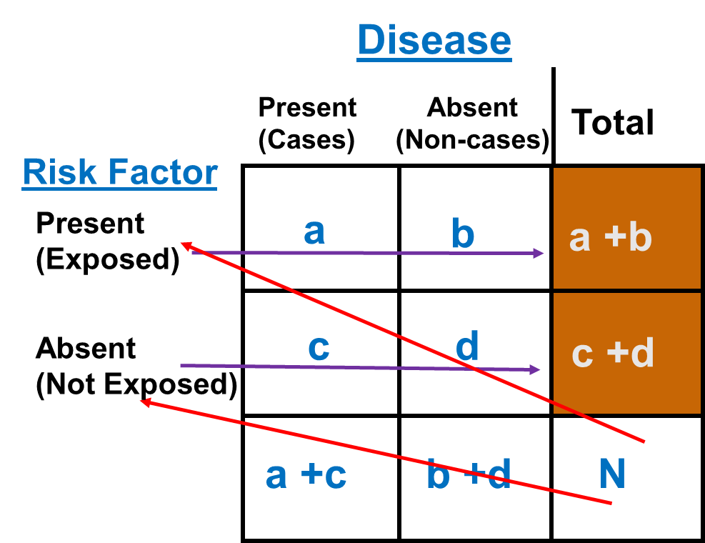
Rothman, Epidemiology: An Introduction 2nd Ed. pp 164-170
Notes:
Let’s switch the gears a little bit and talk about cohort data analysis. You already seen this slide from Module 2. This conventional 2 x 2 table illustrates the cohort study design. In the simplest cohort study design, two groups (exposed and unexposed) are recruited and compared for the presence of disease outcomes. Again, in many large cohort studies, study begins with a total sample of N (selection of cohort). Once we obtain the exposure status, study participants will be placed into exposed group (marginal, noted as a + b) and unexposed group (marginal, noted as c + d). Then we follow these members to ascertain outcomes of interest with multiple visits sometimes.

Slide 14
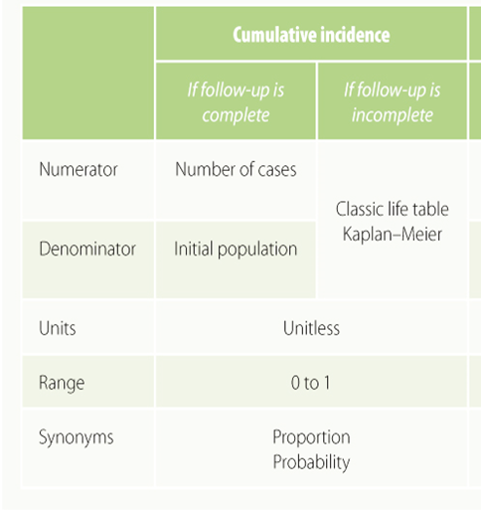
Incidence
Cumulative incidence (a / a+b; time)
a = number of new cases of disease
a + b = total number of people at-risk
over a period of time (e.g., Jan 1-Dec 31, 2018)
$\frac{No. of new cases}{persons at risk } (×1,000 or 100)$
Incidence density (a / a+b; time)
a = number of new cases of disease
a + b = total number of person-time at-risk
over a period of time (e.g., Jan 1-Dec 31, 2018)
S & N textbook p 77
Notes:
Incidence represents new cases of disease that develop over time. In doing so, it describes the rate of development of disease in a population. Incidence can be especially helpful in investigations specific to the etiology of a disease. What causes the onset and/or progression in disease or other health-related outcome? Incidence is the measure of disease occurrence that is particularly well-suited to answering this question. Again, you should be very familiar with the formulae for calculating incidence.
Incidence has been traditionally used to indicate a proportion of newly developed (incident) cases of a disease; however, this measure can be used to characterize the frequency of any new health- or disease-related event. There are two types of measures of incidence defined by the type of denominator: (1) incidence based on persons at risk and (2) incidence based on person-time unit at risk.
Cumulative incidence directly measures the risk of developing the disease – while incidence density considers the rate, or velocity, at which disease occurs. The numerator is the same for both calculations, while the denominator differs. We saved our conversation on incidence density for cohort studies.

Slide 15

Incidence based on individuals at risk
Cumulative incidence – survival analysis
No loss-of-follow-up
Cumulative incidence = # of events/ initial population during the follow up
= incidence based on persons at risk
Losses of follow-up
Outcome of event vs. censored observations = loss of follow-up (collectively)
Cumulative survival (or survival function) with censored observations
Life table of the actuarial type (interval based life table)
Kaplan-Meier method
Cumulative incidence
Cumulative survival
Notes:
Cumulative incidence is the basis for the statistical techniques known as survival analysis. If follow-up is complete on every individual in the cohort, in other words “no loss of follow up” the estimation of the cumulative incidence is simply the number of events occurring during the follow-up time divided by the initial population.
Oppositely, in real situation, there are individuals lost to follow-up, those dying from causes other than the outcome of interest, and those whose follow-up is shorter because they are recruited later in the accrual period for the study. All these losses to follow-up are called censored observations
Life table and Kaplan-Meier method is usually used to estimate cumulative incidence (it complement, cumulative survival or survival function)

Slide 16

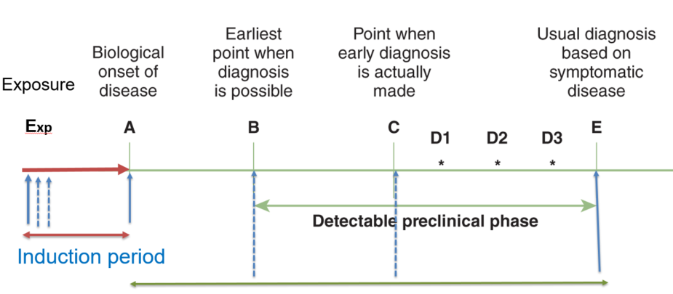
Incidence based on person-time
Two components to calculate incidence rate: 1) # of new cases and 2) person-time at risk
Induction periods (time exposed vs time at risk)
in the denominator is linked to assumptions about induction time.
Contribution to person-years at risk begins when induction time begins.
Notes:
To calculate incidence rate/density, we will need two main components: 1) number of new cases and 2) actual person time at risk. Person-time at risk is an estimate of the actual time at risk according to “ERIC notebook (see reference)” In other words, a subject is eligible to contribute person-time to the study only when that individual does not have the health outcome of interest or is still at risk of developing the health outcome.
According to Modern Epidemiology, “Time at risk” is the time that an individual contributes to the denominator of the incidence rates in a cohort study. We will need to distinguish that ‘time exposed or time during which exposure occurs‘ is different from ‘time at risk. In occupational cohort studies of exposure to certain levels of noise and CVD, for example, time of employment means the time (duration) exposed to the exposure whereas ‘’time at risk for exposure effect” generally comes after the accumulation of occupational noise exposure like shown in the figure. Time at risk for exposure effects can occur even if the workers quit their job. So the person time (time at risk) is linked to assumptions about induction time. In previous module, we discussed the induction time.
Reference: https://sph.unc.edu/files/2015/07/nciph_ERIC4.pdf

Slide 17
How to calculate person-time
Researchers are studying the rate of developing asthma. The researchers enroll 100 participants who have been determined to not have asthma. The researchers plan to follow these participants over one year to see who develops asthma, beginning on January 1st. Participants visit a doctor monthly, at the end of the month, to determine if they have asthma. After one year, 5 of the participants have developed asthma. See below table.
# of new cases at the end of 1 year study period: 5 cases
Person time: ‘person months’ will be calculated
(100 – 5) subjects * 12 months = 1140; 2 subjects * 3 months = 6; 2 subjects * 8 months = 16; 1 subject * 11 months = 11 ➔ Sum: 1173 person-months
Incidence rate of asthma: (# of new cases)/total person time at risk = 5/1173 = 0.0043 or 4.3 per 1,000 person-months.
 | Jan | Feb | Mar | Apr | May | Jun | Jul | Jul | Aug | Sep | Oct | Nov | Dec | Total
Sub | 0 | 0 | 2 | 0 | 0 | 0 | 0 | 0 | 2 | 0 | 0 | 1 | 0 | 5
https://sph.unc.edu/files/2015/07/nciph_ERIC4.pdf
Notes:
Let’s focus on how to calculate person-time using a simple example. This example is a practice question from UNC ERIC notebook.
Based on this calculation, incidence rate for asthma for some exposure is 4.3 per 1,000 person months.
Reference: https://sph.unc.edu/files/2015/07/nciph_ERIC4.pdf

Slide 18
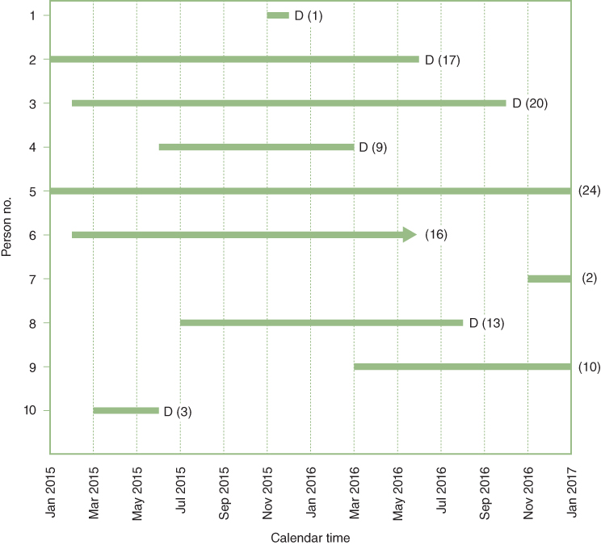
Hypothetical example
Follow up of 10 patients for 2 years
6 Deaths
3 censored before 2 full years of follow-up
1 survived for 2 full years
Question: What is the cumulative Incidence of death (or the cumulative survival) up to 2 years?
SOURCE: Szklo & Nieto (2019)
Notes:
Recall this slide? We used this hypothetical example in Module 2.
The example is provided in our S & N textbook. Data are from a hypothetical cohort of 10 people who are followed over time (up to 24 months or two years), from January 2015 through January 2017. In Module 2, we calculated the cumulative incidence.
Let’s use this example to first calculate the person time at risk.

Slide 19
Example: 2 year cumulative probability death
Reorganize our example:
 |  | Contribution to the total number of person yrs by participants in:
Person No. | Total follow-up (months) | 1 yr. of follow up | 2 year of follow up | Total follow up period
1 | 1 | 1/12 = 0.083 | 0 | 0.083
2 | 17 | 12/12 = 1.000 | 5/12 = 0.417 | 1.417
3 | 20 | 12/12 = 1.000 | 8/12 = 0.667 | 1.667
4 | 9 | 9/12 = 0.750 | 0 | 0.750
5 | 24 | 12/12 = 1.000 | 12/12 = 1.000 | 2.000
6 | 16 | 12/12 = 1.000 | 4/12 = 0.333 | 1.333
7 | 2 | 2/12 = 0.167 | 0 | 0.167
8 | 13 | 12/12 = 1.000 | 1/12 = 0.083 | 1.083
9 | 10 | 10/12 = 0.833 | 0 | 0.833
10 | 3 | 3/12 = 0.250 | 0 | 0.250
Total | 115 | 7.083 years | 2.500 years | 9.583
Notes:
For our example, the person time or person years for the denominator is calculated as 9.583 years.

Slide 20

Example: 2 year cumulative probability death
Step 1: Calculate denominator, i.e. units of time contributed by each individuals, and total (e.g., 9.583 years)
Step 2: Calculate rate per person-year for the total follow-up period:
For our example
$$Incidence density \left(rate\right)= \frac{6 events}{9.583 years}=0.63 per person years$$
Notes:
If we re-use our example to calculate person time, we can follow two steps to calculate total person time.
We have 6 events. If you recall, incidence density or rate is based on number of events divided by person time or person at risk.
So, it is possible for us to calculate the incidence rates per person-years for overall period i.e., 2 years in this example, or to calculate separately for shorter periods during the follow-up, such as year 1 and year 2. More detailed information how to calculate person time on next slide.

Slide 21
Notes
Rates have units (time⁻¹).
Proportions (e.g., cumulative incidence) are unitless.
As velocity, rate is an instantaneous concept. The choice of time unit used to express it is totally arbitrary. Depending on this choice, the value of the rate can range between 0 and ∞.
E.g.: 0.024 per person-hour = 0.576 per person-day
= 210.2 per person-year
Notes:
A couple of notes on incidence rate (or density) based on person-times. Incidence rates are not proportions.
They are obtained by dividing the number of events by the amount of time-at-risk (pooling all study participants) and are measured in units of time^{–1}. As a result, a rate can range from 0 to infinity, depending on the unit of time being used.
The time unit used depends on investigators and is usually selected on the basis of the frequency of the event under study. The main reason that many epidemiologic studies use person-years as the unit of analysis is because it is a convenient way to express rare events. When one is studying relatively frequent health or disease events, it may be more convenient to use some other unit of time like person-weeks for influenza epidemic to calculate incident cases of influenza.

Slide 22
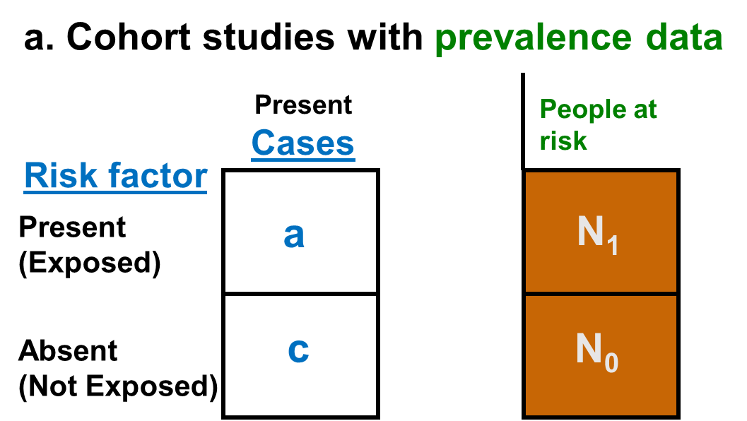
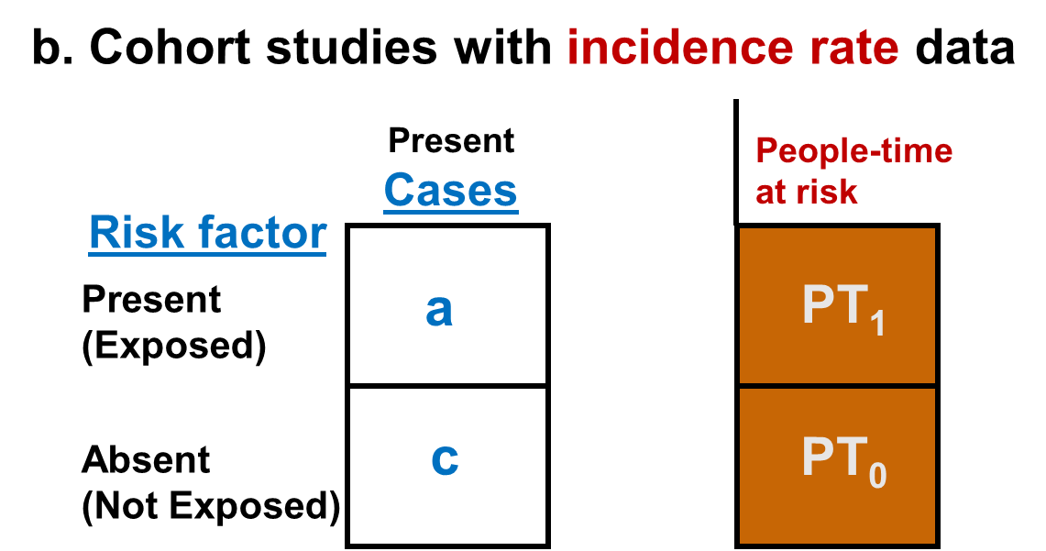
Rothman, Epidemiology: An Introduction 2nd Ed. pp 164-170
Notes:
Let’s tailor this conventional 2 x 2 table to include appropriate information to measures the effect of an exposure in cohort studies.
If a cohort study followed all subjects for a fixed period of time and there were no other important competing risk factors and no confounding, we could display the captured data as shown in Table a.
For a cohort study that allow for different follow-up periods for each subject, we could measures incidence rates and the data can be displayed as shown in Table b.

Slide 23
Measures of association used in a cohort study
Relative differences
Risk ratio: ratio of two cumulative incidences between exposed and not exposed groups
-Risk ratio of cumulative incidence (CIR) = [a / N₁] / [c / N₀]
Rate ratio: ratio of two incidence densities or incidence rates
– Rate ratio of incidence rate (IRR) = [a / PT₁ ] / [c / PT₀]
Odds ratios: ratio of two odds
A measure of the strength of the association between a factor and an outcome
Also applies to other related association measures
Hazard ratio
Absolute risk difference (attributable risk) between two incidence probabilities
- A measure of the public health impact of the risk factor, and it focuses on the number of cases that could potentially be prevented by eliminating the risk factor
Notes:
Frequently, a term "relative risk" is used to encompass risk ratio and rate ratio as well. These relative measures give an indication of the "strength of association.“ Risk ratio is the ratio of the cumulative incidences in the exposed and unexposed groups. Rate ratio is the ratio of incidence rates or density in the exposed and unexposed groups. Please see the numerators and denominators in Table a and Table b on slide 20. For example, the incidence rate ratio can be calculated as follows: a ratio between cases (a) divided by people time at risk (PT₁) in the exposed group and cases (c) divided by people time at risk (PT₀) in the unexposed group.
An alternative definition of an instantaneous incidence rate (density) is the hazard rate. In the context of a cohort study, the hazard rate is defined as each individual’s instantaneous probability of the event at precisely time t (or at a small interval [t, t+Δt]), considering the fact that the individual was at risk at time t. The hazard rate is defined for each particular point in time during the follow-up. Hazard ratio is the ratio of hazard rate and will be explained using survival analysis technique. We will review a little bit more of life table, survival curve and cox-proportional regression model in a different module slides.
Absolute risk difference or attributable risk in the exposed is often used to study the public health impact of the risk factor on outcome.

Slide 24
(1-alpha)%Confidence Interval
Desired z values for 90%, 95%, or 99%CI: 1.645, 1.96, or 2.576
Risk ratio of cumulative incidence (CIR) = [a / N₁] / [c / N₀]
- 95%CI for CIR
$exp\left\{logCIR ±1.96×SE (\log{CIR)}\right\},$where SE(log CIR) = $\sqrt{\frac{1}{a}−\frac{1}{N_{1}}+\frac{1}{c}−\frac{1}{N_{0}}}$
Rate ratio of incidence rate (IRR) = [a / PT₁ ] / [c / PT₀]
- 95%CI for IRR
$exp\left\{logIRR ±1.96×SE (\log{IRR)}\right\},$where SE(log IRR) = $\sqrt{\frac{1}{(a)}+ \frac{1}{(c)}}$
‘Log’ = natural logarithm
Rothman, Epidemiology: An Introduction 2nd Ed. pp 164-170
Notes:
Using the equations in this slide, we can calculate the interval estimates of cumulative incidence risk ratio (CIR) or incidence rate ratio (IRR) as well.

Slide 25
Example: Cumulative incidence for 20 year follow-up
Cumulative incidence for those exposed to SHS: ?
Cumulative incidence for those NOT exposed to SHS: ?
CIR = ?
95%CI for CIR: ?
Interpretation of CIR and 95%CI for CIR?
Second hand smoking (SHS) (exposure) | N of myocardial infarction (Cases) | People at risk
Yes | 120 | 20,000
No | 90 | 23,000
Notes:
Let’s calculate cumulative incidence using an example. Consider that the investigators are examining the relationship between second-hand smoking exposure due to spousal smoking and heart attack in postmenopausal women over the 20 year period of observation. Please calculate the cumulative incidence risk ratio and 95%CI of CIR

Slide 26
Example: Cumulative incidence for 20 year follow-up
Second hand smoking (SHS) (exposure) | N of myocardial infarction (Cases) | People at risk
Yes | 120 | 20,000
No | 90 | 23,000
Cumulative incidence for those exposed to SHS: 120/20,000 = 6.0 per 1000 or 0.0060
Cumulative incidence for those NOT exposed to SHS: 90/23,000
= 3.913 per 1000 or 0.0039
CIR = 0.0060/0.0039 = 1.533 for 20 year follow-up
95%CI for CIR: exp{log*(1.533) ± 1.96*0.139} ~= exp{0.154, 0.701} ~ (1.167, 2.015)
Log means natural logarithm function (i.e., ln)
http://sphweb.bumc.bu.edu/otlt/MPH-Modules/QuantCore/PH717_ComparingFrequencies/PH717_ComparingFrequencies9.html
Notes:
Based on cumulative incidences for exposed and not exposed group to second hand smoking, the cumulative incidence ratio is about 1.533 suggesting that post-menopausal women who were exposed to spousal second hand smoking had 1.533 times the risk of having MI compared to post-menopausal women who were not exposed to second hand smoking over the 20 year period of observation. Based on this CIR, we are 95% confident that the true risk ratio falls between 1.167 and 2.013. Or the harmful effect of SHS ranges from a 17% higher risk to a 101% higher risk, measured in relative terms.

Slide 27
Example: Incidence rate
The Nurses Health Study
Incidence rate for those exposed to HRT: ?
Incidence rate for those NOT exposed to HRT: ?
IRR = ?
95%CI for IRR: ?
Interpretation of IRR and 95%CI for IRR ?
Post menopausal HRT use | N of coronary artery disease (cases) | Person-years of follow-ups (people-time at risk)
Yes | 30 | 54,308.7
No | 60 | 51,477.5
http://sphweb.bumc.bu.edu/otlt/MPH-Modules/QuantCore/PH717_ComparingFrequencies/PH717_ComparingFrequencies9.html
Notes:
Let’s use the example from Nurses’ Health Study (NHS) copied from Boston University course.
Consider that NHS investigators are examining the effects of hormone replacement therapy (HRT) on heart disease in post-menopausal women.
Please try to calculate IR, IRR and 95%CI for IRR.

Slide 28
Example: Incidence rate
Post menopausal HRT use | N of coronary artery disease (cases) | Person-years of follow-ups (people-time at risk)
Yes | 30 | 54,308.7
No | 60 | 51,477.5
Incidence rate for those exposed to HRT: 30/54308.7 = 55.2 per 100,000 person years
Incidence rate for those NOT exposed to HRT: 60/51,477.5 = 116.6 per 100,000 person years
IRR = 55.2/116.6 = 0.474
95%CI for IRR: exp{log(0.474) ± 1.96*0.224} = exp{-1.184, -0.308} → (0.306,0.735)
http://sphweb.bumc.bu.edu/otlt/MPH-Modules/QuantCore/PH717_ComparingFrequencies/PH717_ComparingFrequencies9.html
Notes:
Based on incidence rates for exposed and not exposed group to HRT, the incidence rate ratio is about 0.474 suggesting that post-menopausal women who used HRT had 0.47 times the rate (or risk) of coronary artery disease compared to post-menopausal women who did not use HRT. Based on this rate ratio, we are 95% confident that the true rate ratio falls between 0.306 and 0.735.

Slide 29
Risk Difference/Rate Difference
The excess risk than can be attributed to having had the exposure
Caution: The term (Attributable risk) presumes a causal relationship but in fact it may represent only an estimate (association) of the causal relationship.
It is useful for the study of the primary prevention or screening impact in clinical practice and public health
Risk difference = cumulative incidence in exposed group – cumulative incidence in unexposed group
Rate difference = Incidence rate (or density) in exposed group - Incidence rate in unexposed group
Notes:
As we already learned from Module 2, the risk difference or absolute difference is to concentrate on the number of cases that could potentially be prevented by eliminating the risk factor. This means that we assume that the relationships between a risk factor (or exposure) and outcome to be causal. However, the significant associations between risk factors and outcomes may not be always causal relationships. Thus, we will need to be cautious when we interpret the risk or rate difference. While the risk difference is calculated by using cumulative incidence, the rate difference is calculated by subtracting the incidence rate in the unexposed group (or least exposed group) from the incidence rate in the group with the exposure.

Slide 30
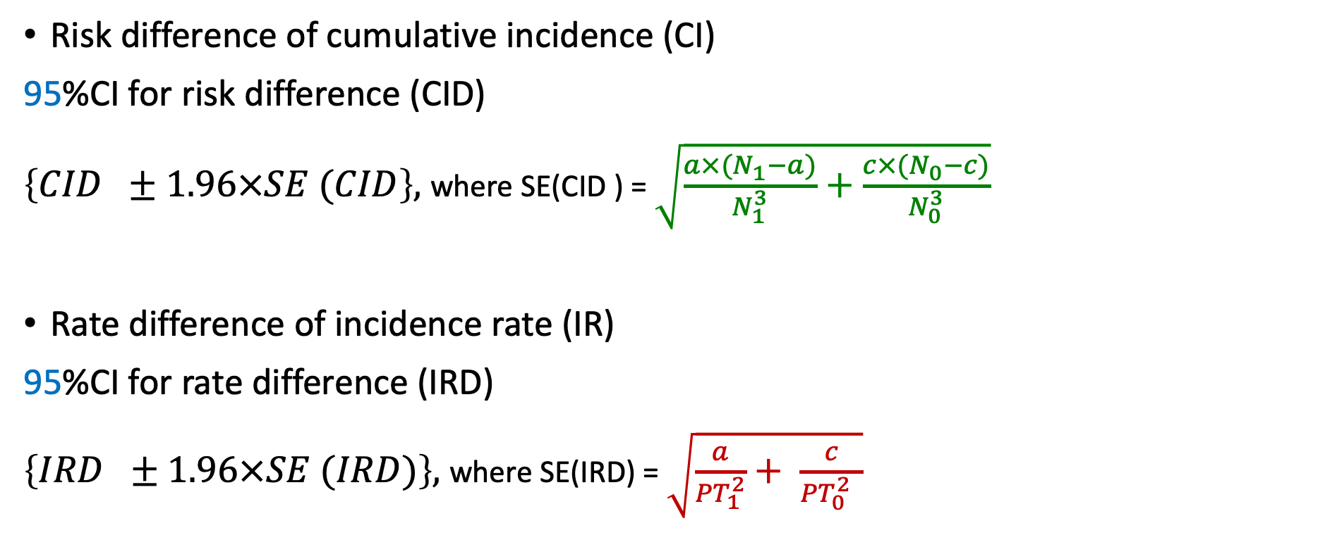
(1-alpha)%Confidence Interval
Risk difference of cumulative incidence (CI)
95%CI for risk difference (CID)
$\left\{CID ±1.96×SE (CID\right\},$where SE(CID ) = $\sqrt{\frac{a×(N_{1}−a)}{N_{1}^{3}}+\frac{c×(N_{0}−c)}{N_{0}^{3}}}$
Rate difference of incidence rate (IR)
95%CI for rate difference (IRD)
$\left\{IRD ±1.96×SE (IRD)\right\},$where SE(IRD) = $\sqrt{\frac{a}{{PT}_{1}^{2}}+ \frac{c}{{PT}_{0}^{2} }}$
Rothman, Epidemiology: An Introduction 2nd Ed. pp 164-170
Notes:
Using the equations in this slide, we can calculate the interval estimates of (cumulative incidence) risk difference or (incidence rate) rate difference between exposed and unexposed group for the outcome. Please note that the confidence interval calculations for risk difference and rate difference do not require exponentiation of lower and upper values.
Reference; Rothman KJ. Epidemiology: An introduction 2nd edition, pp 164-170

Slide 31
Example
Second Hand Smoking and MI example
Risk difference = ?
95%CI for risk difference = ?
HRT and coronary artery disease example
Rate difference = ?
95%CI for rate difference = ?
Notes:
Let’s use our previous two examples to calculate risk difference and rate difference here.

Slide 32
Example
Second Hand Smoking and MI example
Risk difference = 0.00209 or 2.09 per 1000
95%CI for risk difference = 0.00209 ± 1.96*0.000674 → (0.00075, 0.00343)
HRT and coronary artery disease example
Rate difference = -0.000613 or -61.3 per 100,000 person years
95%CI for rate difference = - 0.000613 ± 1.96*0.000181 →
~(-0.000968, -0.000258) ➔ -96.8 per 100,000 person years, -25.8 per 100,000 person years
Notes:
For the first example, we can interpret the risk difference of 2.09 per 1000 as following: Assuming there is a cause-effect relationship, there about 2.09 excess MI cases per 1000 women in the group that were exposed to second hand smoking due to spousal smoking, compared to the group of postmenopausal women who did not exposed to second hand smoking over 20 year follow up. We are 95% confident that the true risk difference lies between 0.7 per 1000 and 3.4 per 1000 excess cases of MI over 20 years.
For the second example, it is a little bit tricky to explain. Post-menopausal women who were exposed to HRT had 61.3 (or 62) fewer cases of CAD per 100,000 person-years compared to post menopausal women who were not exposed HRT. According to this sample, we are 95% confident that true rate difference lies between 96.8 and 25.8 fewer cases of CAD per 100,000 years among women who were exposed to HRT in comparison with women who were not.

